Slide 1
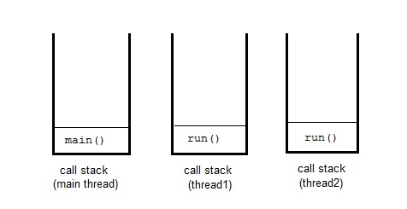
Multithreading in Java
Multithreaded programs contain two or more threads that can run concurrently. This means that a single program can perform two or more tasks simultaneously. For example, one thread is writing content on a file at the same time another thread is performing spelling check.
In java each thread has its own call stack.
Thread of execution means an individual "lightweight" process that has its own call stack.

Slide 2
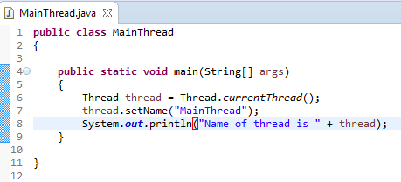
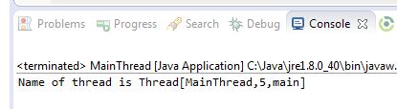
Multithreading in Java
Even if you don't create any thread in your program, a thread called main thread is still created. Although the main thread is automatically created, you can control it by obtaining a reference to it by calling currentThread() method.
Two important things to know about main thread are,
It is the thread from which other threads will be produced.
main thread must be always the last thread to finish execution.

